Slide 1

Portfolio Optimization– Crypto Currency
Shinan

Slide 2
Crypto currency – Digital asset
Gold vs Bitcoin (digital gold per say)
1 ounce glod ≈ $1770 as of 17.02.21 ≈ 0,028kg
What about carry 1 Trillion Dollar?
1 T$ ≈15,819,209 kg gold = 1 wallet BTC address which is just a line of hash code.

Slide 3
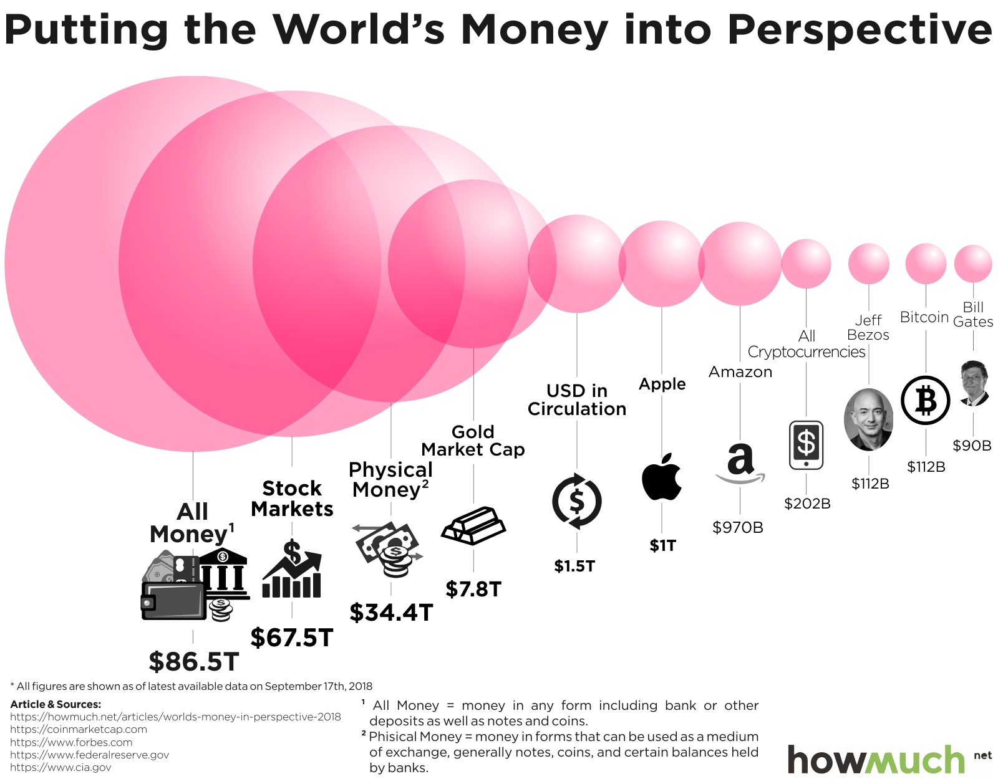
Why I think it has potential?

Slide 4
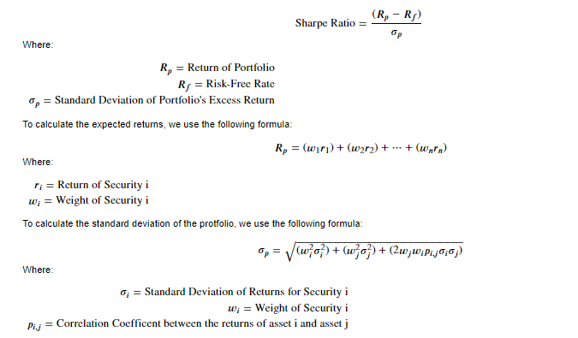
Applying Monte Carlo Simulation to optimize the portfolio
Data : downloaded from Coingecko API
Used metrics: return, volatility (Std), Sharpe ratio which are standard measurements on the traditional assets class such as for stocks.

Slide 5
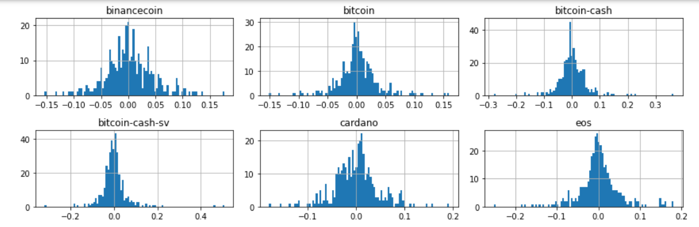
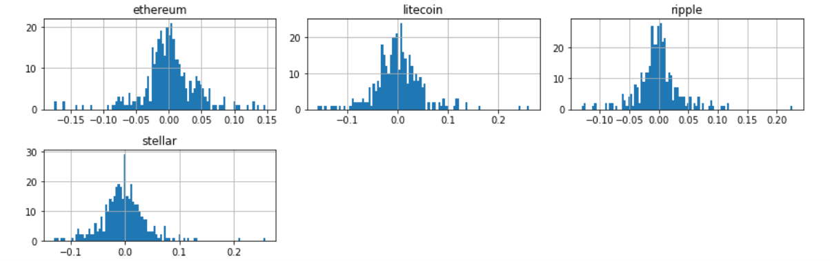
Applying Monte Carlo Simulation to optimize the portfolio

Slide 6
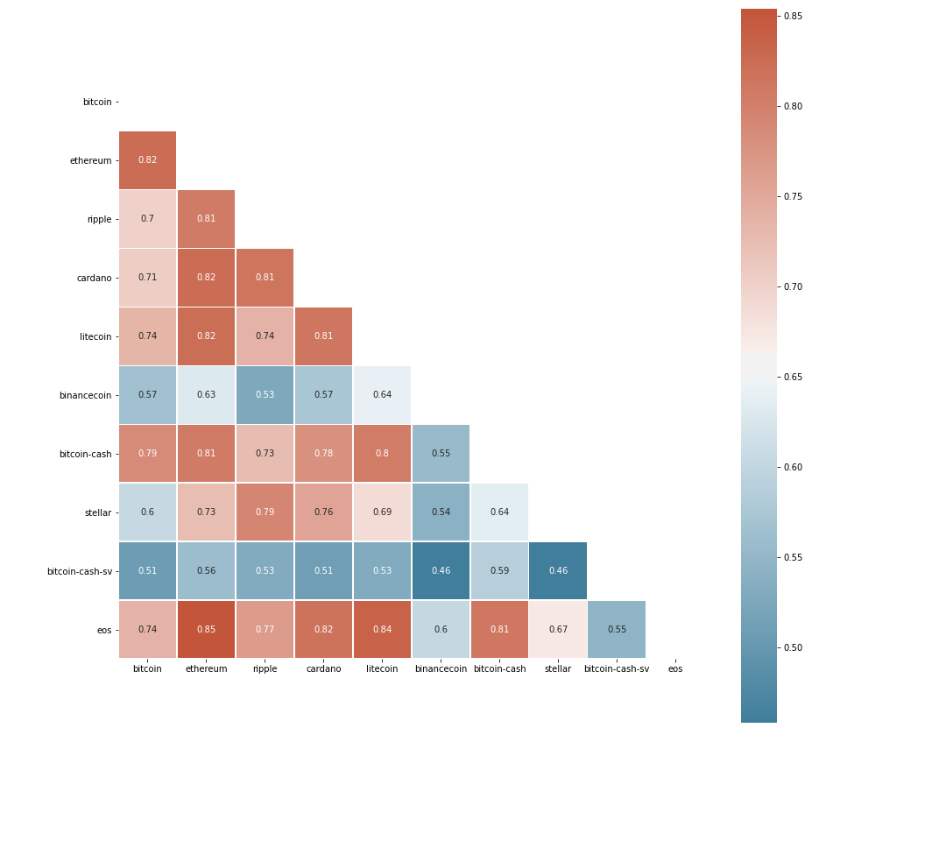
The majority coins are highly correlated to each other except Binance Coin and BSV.
Normally we should built the portfolio with lower correlated assets.

Slide 7
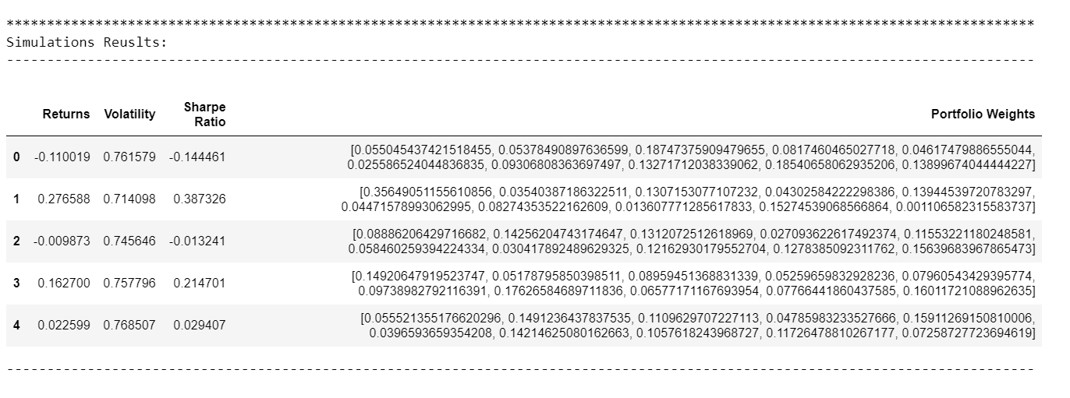
Simulation results : It ran 10.000 times and the results stored in an a dataframe

Slide 8
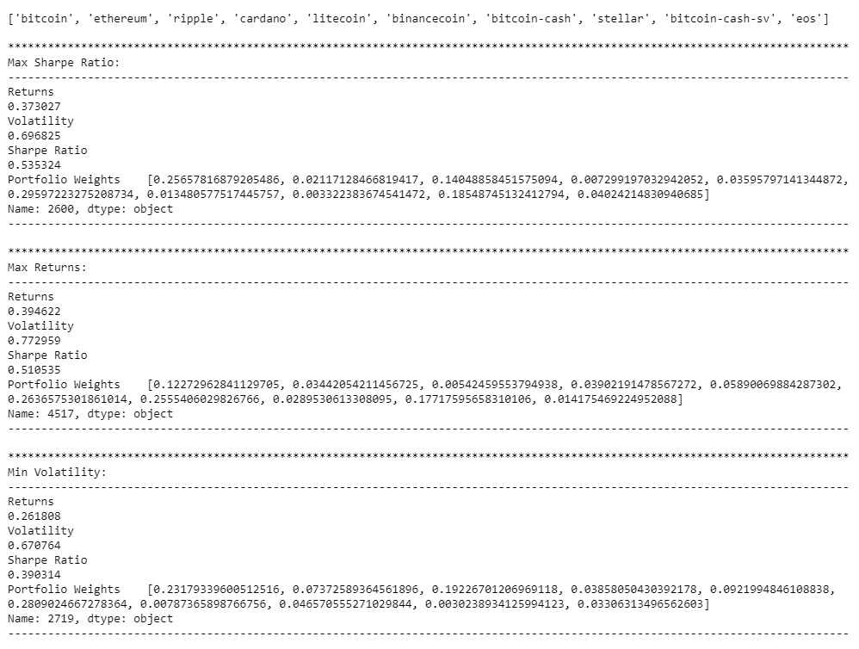
Results: highest return highest Sharpe ratio lowest risk / volatility

Slide 9
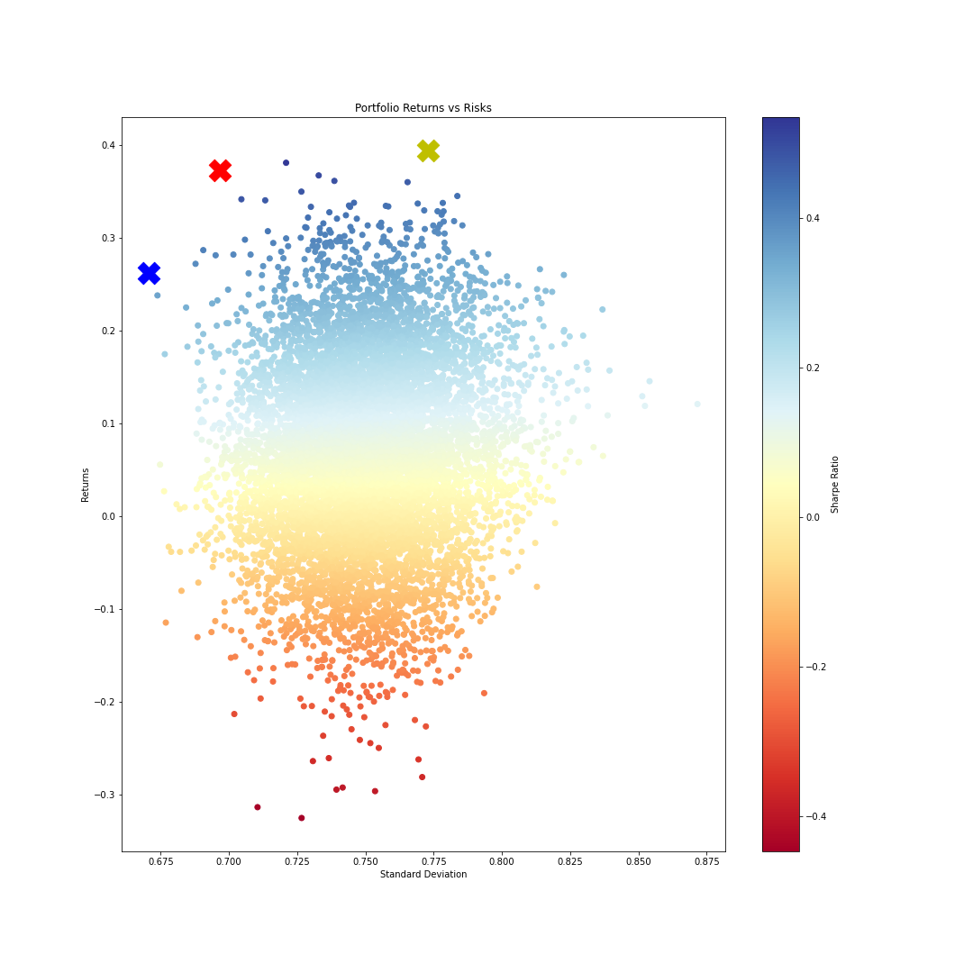
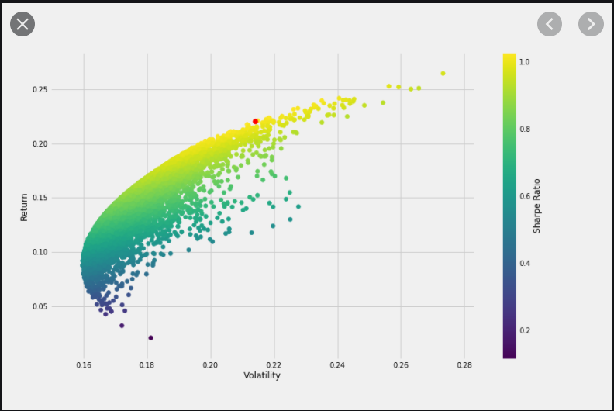
Plotting results

Slide 10
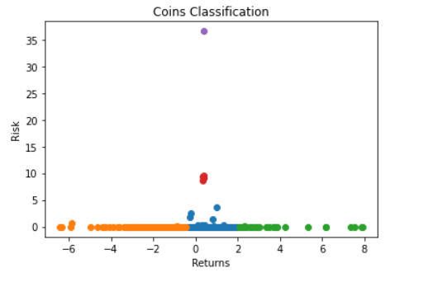
Classification with 1.883 different coins

